Slide 1


Sophia Project: Enhancing Player Immersion with Intelligent Autonomous NPCs in 2D RPGs
André Luiz França Batista
Instituto Federal do Triângulo Mineiro
Notes:
"Good morning everyone. Today I'm presenting the Sophia Project—an AI system that transforms how players interact with NPCs in games. Instead of repetitive, scripted characters, Sophia creates NPCs that remember you, adapt to your behavior, and respond with genuine emotion. Let me show you how we built this."

Slide 2
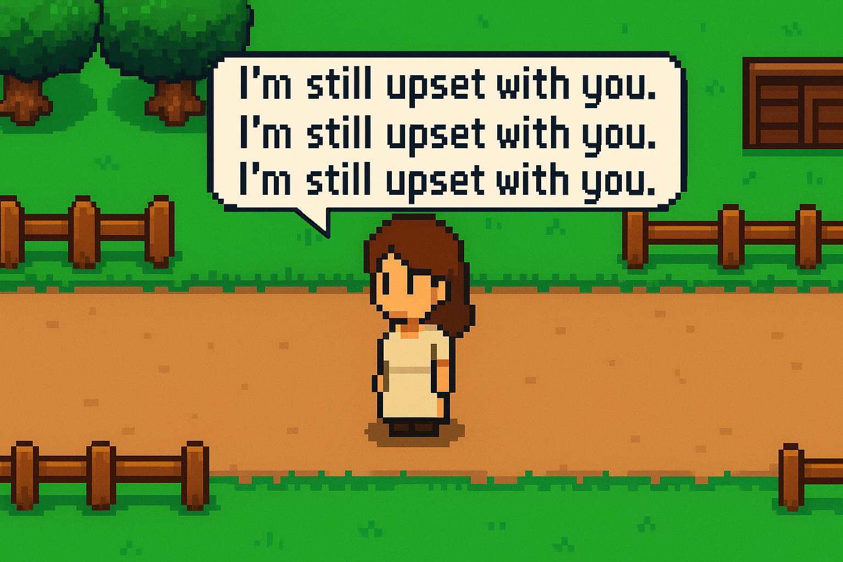

The problem
Notes:
"We've all experienced this frustration in games. You talk to an NPC, and they repeat the exact same lines every time. They don't remember you. They don't react to what you've done. This breaks immersion and makes game worlds feel hollow. Traditional NPCs use rigid decision trees—they can't learn, can't adapt, and certainly can't form real relationships with players. We wanted to solve this problem."

Slide 3
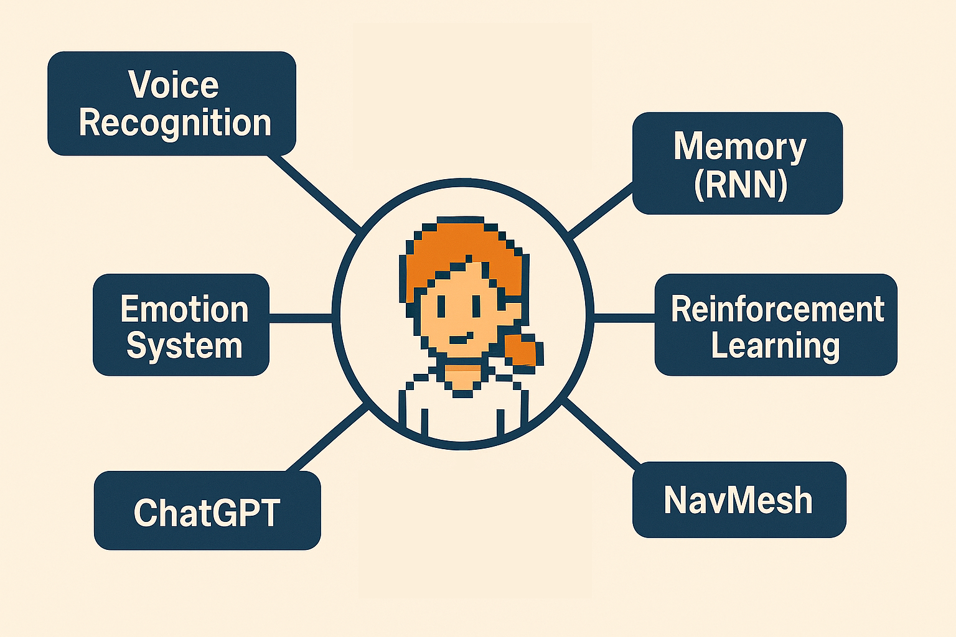
The Sophia Solution
Notes:
"Sophia integrates six AI technologies working together. First, voice recognition captures not just your words, but your emotional tone—are you angry, sad, or cheerful? Second, ChatGPT generates contextually appropriate responses. Third, a recurrent neural network creates persistent memory—Sophia remembers past conversations and events. Fourth, deep Q-learning allows her to learn optimal behaviors through reinforcement. Fifth, NavMesh enables emotionally-driven movement—if she trusts you, she approaches; if afraid, she retreats. Finally, a dynamic relationship system tracks trust, empathy, and affection. These six modules create an NPC that feels genuinely alive."

Slide 4

How it works
Notes:
"Let me give you a concrete example. Imagine you give Sophia a gift she loves. The system registers this positive interaction, increasing trust by one point. Her facial expression changes to happy, and ChatGPT generates a warm, grateful response. The LSTM network stores this event in her memory. The next day, when Sophia sees you, the deep Q-network evaluates the situation: high trust level, positive history. It chooses the action 'approach player warmly.' She walks toward you using NavMesh and greets you by referencing yesterday's gift.
But what if you then ignore Sophia for several days? Each ignored interaction becomes a negative reinforcement signal. Trust decreases. When you finally approach her again, she remembers this pattern. Her greeting might be distant or even hurt: 'You've been acting strange lately… I'm not sure I can trust you again.' This is persistent, dynamic behavior emerging from the integration of all six AI modules."

Slide 5
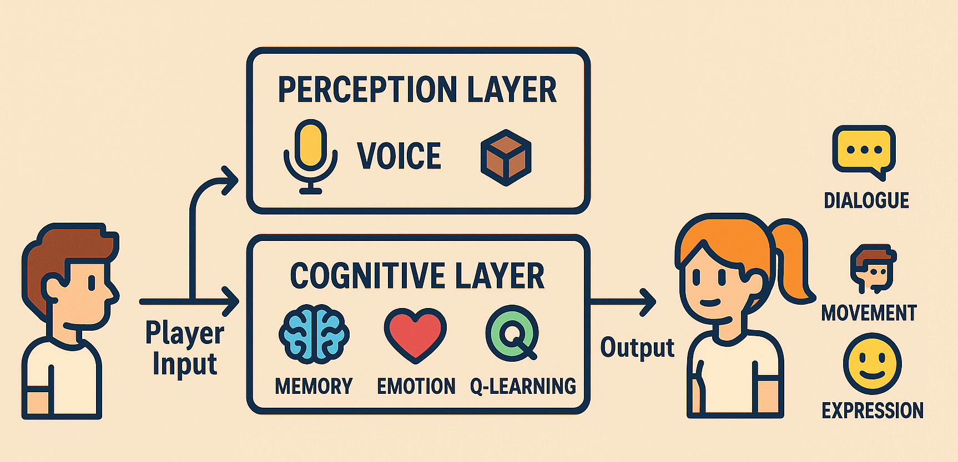
The Technical Architecture
Notes:
"Here's the technical pipeline. Player input—voice, actions, proximity—flows into the perception layer. This data feeds the cognitive layer, where three processes run simultaneously: the LSTM updates memory, the emotion system recalculates relationship values, and the DQN selects the optimal action based on the current state. The selected action then generates three synchronized outputs: natural language dialogue via ChatGPT, physical movement via NavMesh, and emotional expression through animations. All of this happens in real-time, creating seamless, believable interactions."

Slide 6
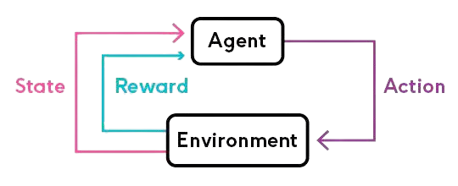
Deep Q-Learning
State: 42 features (location, dialogue tone, trust level, time of the day, etc...)
Actions: 12 possibilities (approach, retreat, start conversation, express emotion, etc...)
Rewards:
Continue conversation: +1 point
Walk away: -1 point
Notes:
"Let's zoom into the reinforcement learning component. Sophia uses a Deep Q-Network trained on the Bellman equation you see here. Every interaction is a state-action-reward sequence. The state includes 42 features: Sophia's location, your recent dialogue tone, trust level, time of day, and nearby objects. From this state, the network chooses one of 12 possible actions—approach, retreat, start conversation, express emotion, and so on.
Rewards are defined by player engagement. If you continue the conversation, Sophia receives plus one point. If you walk away or respond negatively, she receives minus one. Over time, through prioritized experience replay and epsilon-greedy exploration, the network learns which behaviors maximize long-term player satisfaction. This isn't scripted—it's learned behavior that adapts to each individual player's interaction style."

Slide 7
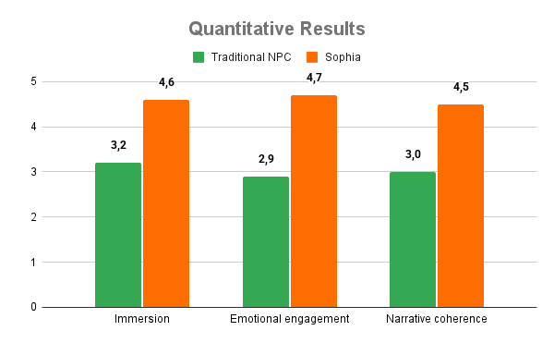
Research Study Results
Notes:
"We conducted a controlled study with thirty participants using A-B testing. Each person played two identical game scenarios—one with a traditional scripted NPC, one with Sophia. We measured immersion, emotional engagement, and behavioral believability using validated questionnaires.
The results were statistically significant across all metrics. On a five-point scale, immersion jumped from 3.2 to 4.6. Emotional engagement increased from 2.9 to 4.7. Participants described traditional NPCs as 'predictable' and 'flat,' while Sophia was consistently described as 'lifelike,' 'attentive,' and 'emotionally intelligent.'
Most powerfully, interaction frequency increased by sixty-five percent, and conversation length grew by forty percent. Players voluntarily spent more time with Sophia because the interactions felt meaningful. One participant said: 'It felt like she genuinely remembered who I was and what I had gone through.' This is the power of combining memory, emotion, and adaptive learning."

Slide 8
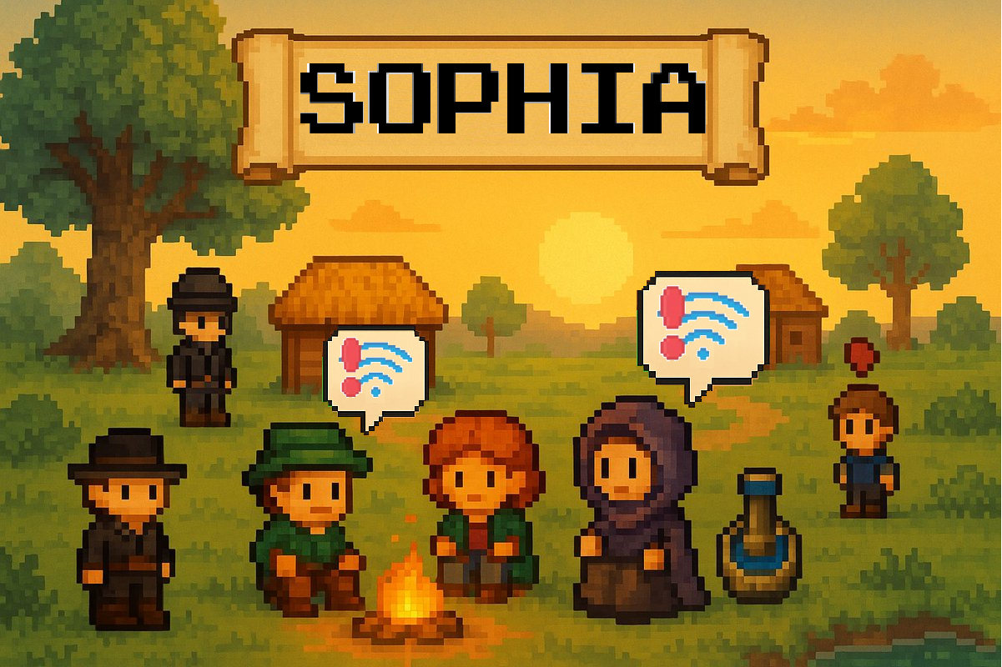
Current Limitations
Notes:
"Sophia currently has one major limitation: internet dependency. We use the cloud-based ChatGPT API for dialogue generation, which requires constant connectivity and introduces latency. This creates problems for offline gameplay, raises privacy concerns, and incurs ongoing API costs.
Our solution is already in development. We're integrating local open-source language models—specifically Mistral 7B—that run entirely on the player's device. We're combining this with XTTS for real-time voice synthesis. Early prototypes show we can achieve comparable dialogue quality with zero latency and complete privacy, while supporting fully offline gameplay."

Slide 9

Future Vision
Notes:
"Our vision extends far beyond a single NPC. Imagine an entire game world populated with autonomous agents—each with unique personalities, memories, and goals. These NPCs don't just interact with you; they interact with each other. They form relationships, remember conflicts, gossip about player actions, and create emergent social dynamics.
We're developing a full 2D RPG that serves as a testbed for this vision. Think Stardew Valley, but every character has Sophia's intelligence. The baker remembers you forgot their birthday. The blacksmith's daughter avoids you because you were rude to her father. The mayor's trust in you affects how other NPCs perceive you. This creates living, breathing game worlds where your actions have persistent, cascading consequences across an entire NPC society.
We're also researching the ethical implications—how do players form bonds with emotionally intelligent NPCs? What are the psychological effects? These are questions we must address as this technology matures."

Slide 10




Impact & Applications
Entertainment
Education
Therapy
Training
Notes:
"The applications extend beyond entertainment. In education, imagine history lessons where you converse with emotionally responsive historical figures who remember your previous discussions. In therapy, AI companions could provide consistent, empathetic support while respecting privacy through local processing. In training simulations, professionals could practice difficult conversations with NPCs that react realistically to tone and approach.
Sophia demonstrates that we can create artificial social intelligence that enhances human experiences without sacrificing privacy, control, or ethical responsibility. This technology isn't just about better games—it's about better human-AI interaction across domains."

Slide 11


Contact information
André Luiz França Batista
andreluiz@iftm.edu.br

Slide 12

Sophia Project: Enhancing Player Immersion with Intelligent Autonomous NPCs in 2D RPGs
André Luiz França Batista
Instituto Federal do Triângulo Mineiro
Notes:
"To conclude: Sophia proves that intelligent, emotionally responsive NPCs are possible today using existing AI technologies. By combining reinforcement learning, persistent memory, natural language processing, and affective computing, we've created characters that remember, adapt, and genuinely engage players.
This represents a paradigm shift from scripted content to emergent narrative. The code is open-source and available on GitHub. I'm happy to answer your questions. Thank you."

Slide 13

BOLOGNA
+9300 km
ITUIUTABA

Slide 14
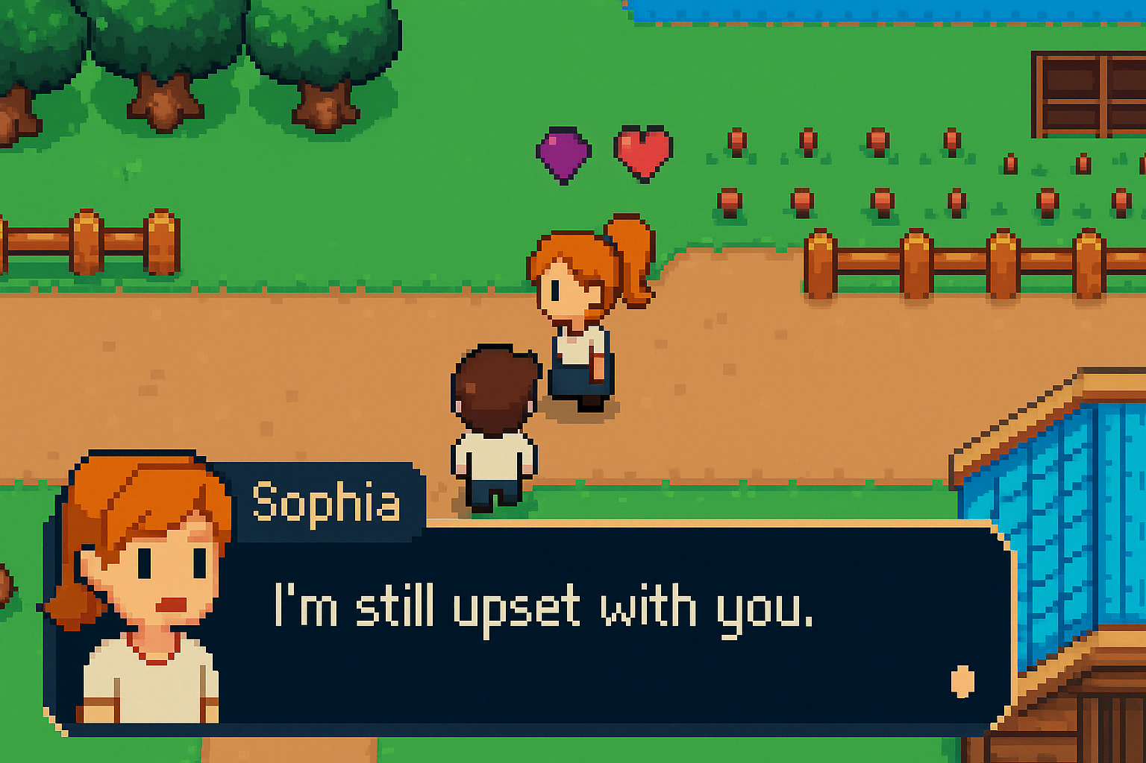

Slide 15


Slide 16
